Slide 1
THE FINLAB TOOLKIT
OBJECTIVE
To introduce gamification as an approach to look at enhancing engagement of users.
TOOL
Gamification

Slide 2
THE FINLAB TOOLKIT
ABOUT ‘Gamification’
Gamification is the process of taking something that already exists – a website, an enterprise application, an online community – and integrating game mechanics into it to motivate participation, engagement, and loyalty. Gamification takes techniques that game designers use to engage players, and applies them to non-game experiences to motivate actions. Gamification is not about creating something new. It is about amplifying the effect of an existing, core experience by applying the motivational techniques that make games so engaging. When you gamify high-value interactions with customers, employees, and partners, you drive more sales, stronger collaboration, better ROI, deeper loyalty, higher customer satisfaction and more.

Slide 3
TOOL: GAMIFICATION DESIGN
THE FINLAB TOOLKIT
GAME CONCEPT
What are we looking to gamify?
What is the broad goal we want to achieve?
Who are we gamifying for? What is the profile of the participant/user?
What is the broad concept? What is the name?
GAME MECHANICS | Ideas
Missions (individuals & team) What are the broad missions or journeys that we want players to undertake? How do we see individual vs. team missions?
Tasks (Output, Quiz, Puzzle, Action etc.) What could be some specific tasks and actions that we want to include as part of the missions and journeys?
Levels How can we organise the missions and tasks in terms of levels of skill, complexity, scale etc.? How do people progress?
Points How do we score or reward people as they complete tasks and missions? What could the points mean for people? When are points allocated? Who allocates the points?
Badges How do we recognise people for displaying skill, efficiency, commitment, collaboration etc. going beyond the points? What do we want to recognise? When to recognise? Who recognises them?
Leaderboards (individuals & team) How do we create transparency by declaring how individuals and teams stand vis a vis the competition in terms of missions, levels, points, badges? Who updates the board? How often is it updated?
GAME DYNAMICS | Ideas
Competition Why are people competing? What are they competing for?
Collaboration How do we get people to work together and in teams?
Community What is the nature and role of the community of people?
Progress (Attitudes, Behaviours & Skills) What is the progress journey we hope people will move on?
Achievement What does achievement mean? How will it be recognised?
Exploration & Surprise How do we offer novelty in terms of the journey?

Slide 4
THE FINLAB TOOLKIT
Gamification Dynamics & Mechanics
What Gamification Dynamics are focused on some of the broad goals and intent behind gamifying a certain area of activity. Game Mechanics are some of the ways a gamified experience can be created.

Slide 5
THE FINLAB TOOLKIT
GAMIFICATION | GAME DYNAMICS & MECHANICS
COMPETITION
How I’m doing compared to others.
Showing users how they compare to others, as individuals or in teams. Competition is enhanced by time-based, team and individualized leaderboards based on rank or score.

Slide 6
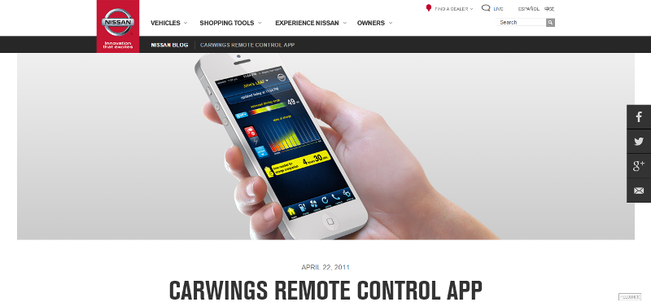
THE FINLAB TOOLKIT

Slide 7
THE FINLAB TOOLKIT
GAMIFICATION | GAME DYNAMICS & MECHANICS
COLLABORATION
Accomplish a goal working with others.
Users working as teams to accomplish tasks, to drive competition, and to encourage knowledge sharing. Team members may be recognised (through points or badges) for contributing to a group’s success.

Slide 8
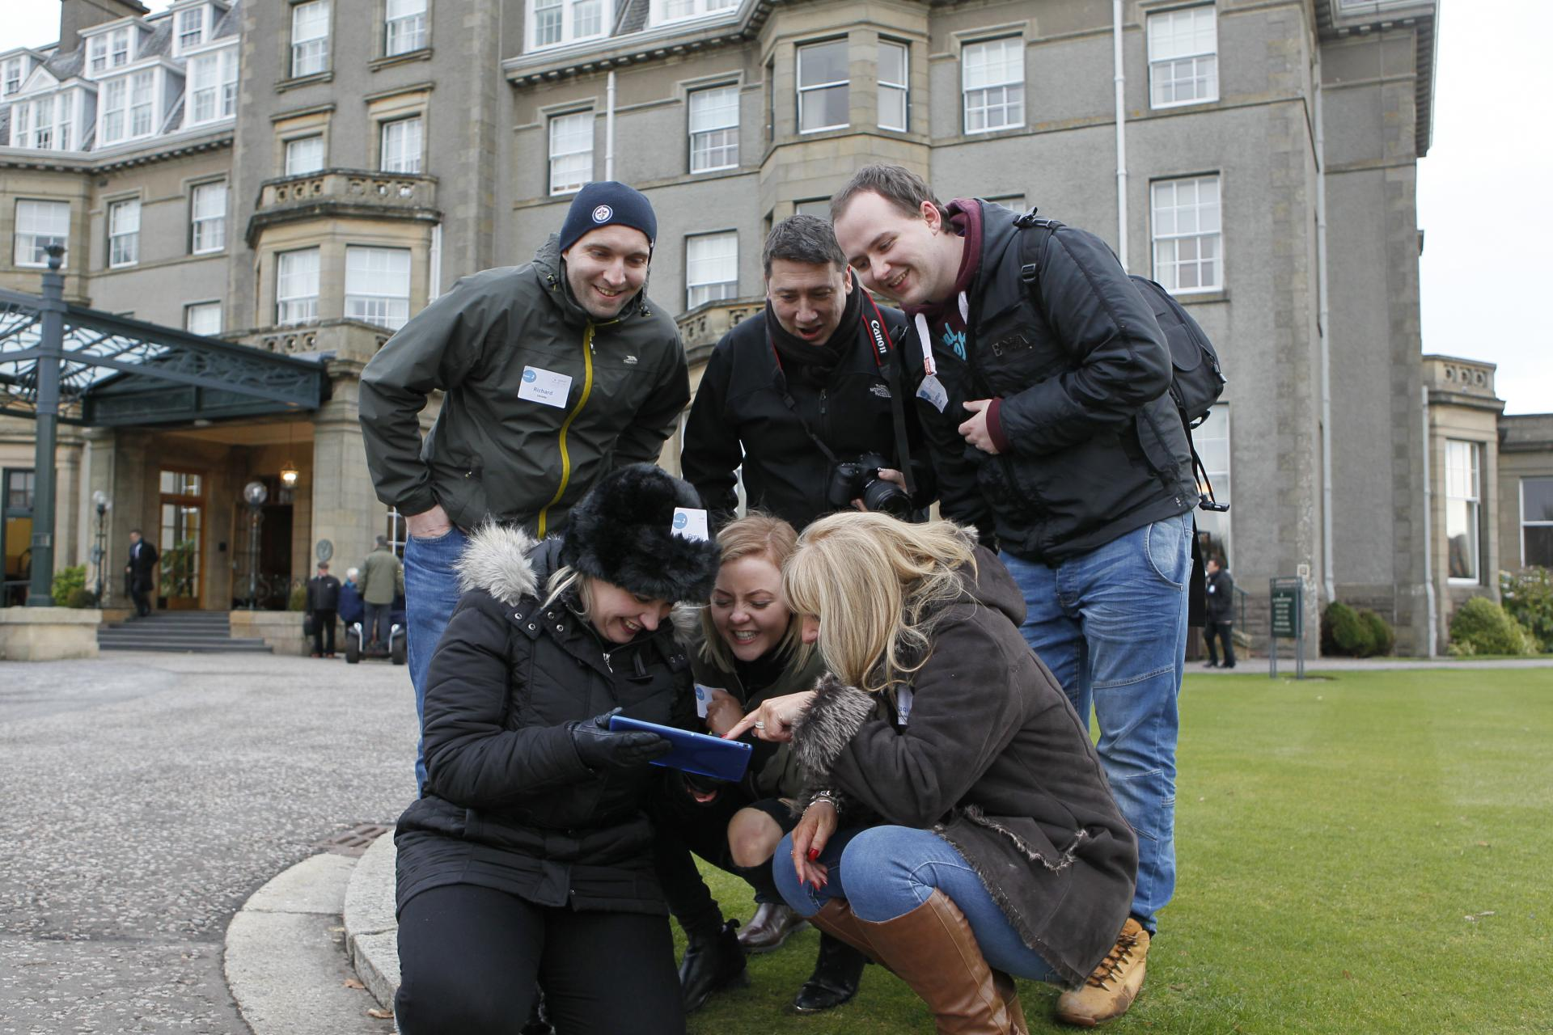
THE FINLAB TOOLKIT

Slide 9
THE FINLAB TOOLKIT
GAMIFICATION | GAME DYNAMICS & MECHANICS
COMMUNITY
A context for achievement.
Communities give meaning to goals, badges, competitions, and other mechanics. Sharing participant achievements creates energy in the community and increase social standing.

Slide 10
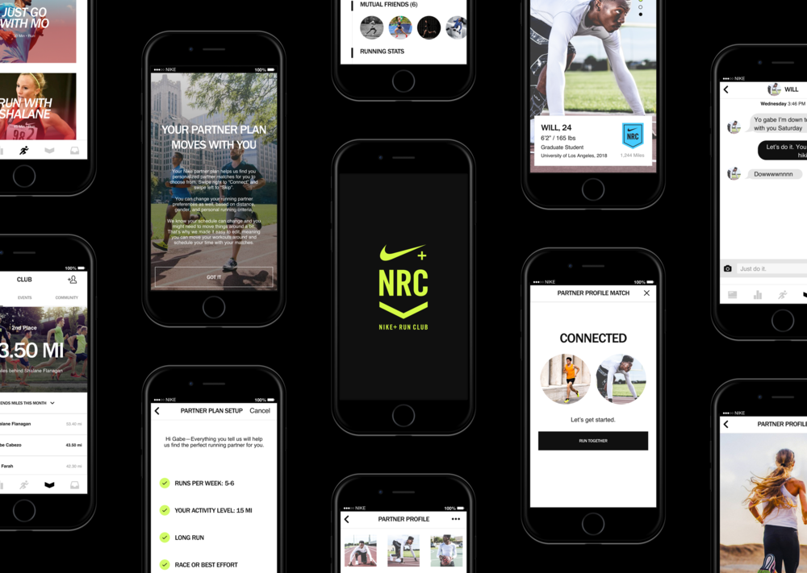
THE FINLAB TOOLKIT

Slide 11
THE FINLAB TOOLKIT
GAMIFICATION | GAME DYNAMICS & MECHANICS
MISSIONS
Short and long-term goals to achieve.
Missions or challenges or journeys give users a purpose for interaction, and educate users about what is valued and possible within the experience.

Slide 12
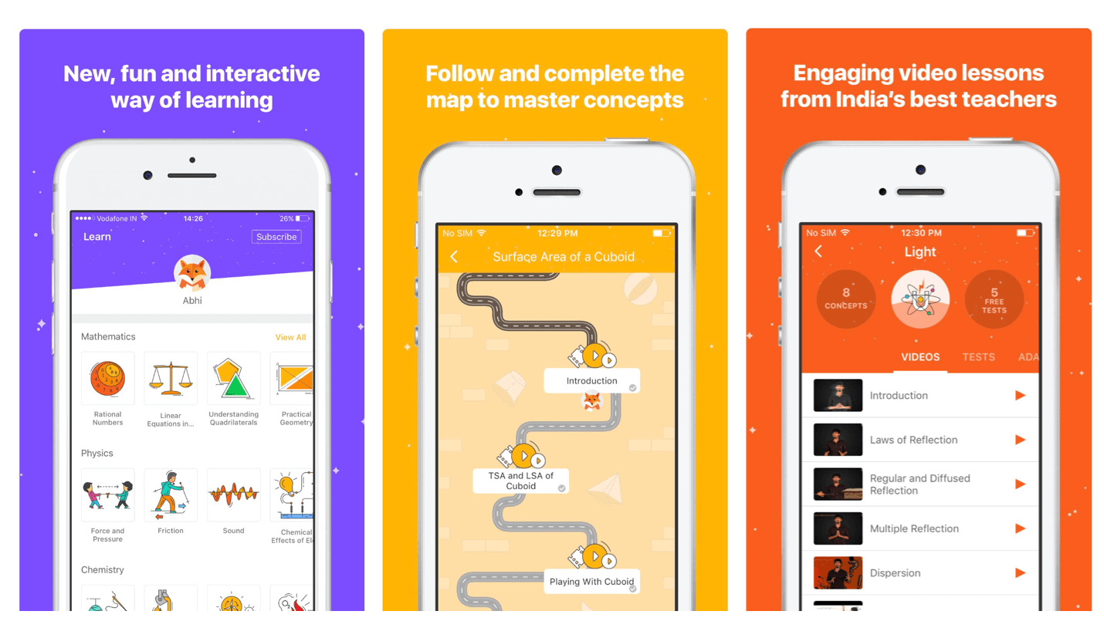
THE FINLAB TOOLKIT

Slide 13
THE FINLAB TOOLKIT
GAMIFICATION | GAME DYNAMICS & MECHANICS
TASKS
Specific actions that achieve goals.
Specific challenges and activities within the missions and levels that are closely tied to the overall purpose of gamification - education, sales, collaboration etc.

Slide 14
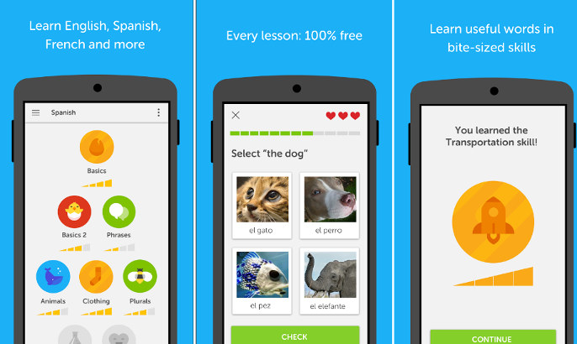
THE FINLAB TOOLKIT

Slide 15
THE FINLAB TOOLKIT
GAMIFICATION | GAME DYNAMICS & MECHANICS
POINTS
Tangible evidence of accomplishments
Points help keep score and establish status or can even be used as currency to purchase virtual or real goods. Points can be earned by completing tasks within missions, completing missions, for collaborating etc.

Slide 16
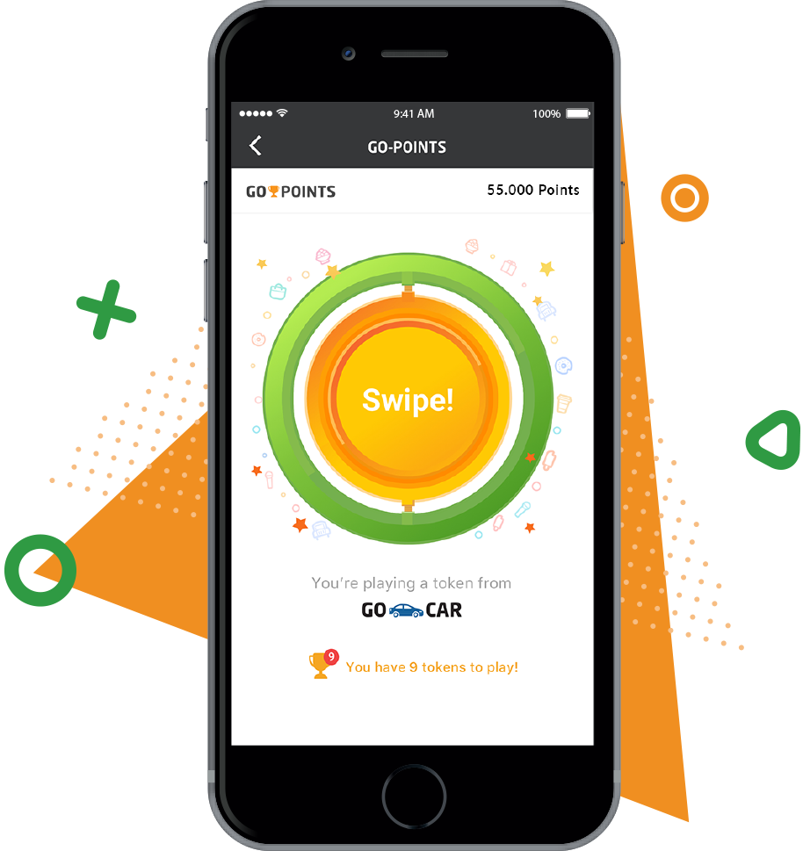
THE FINLAB TOOLKIT

Slide 17
THE FINLAB TOOLKIT
GAMIFICATION | GAME DYNAMICS & MECHANICS
BADGES
Evidence of accomplishments
An indicator of accomplishment or mastery of a skill is especially meaningful within a community that understands its value. Used to identify skills and expertise within a group.

Slide 18
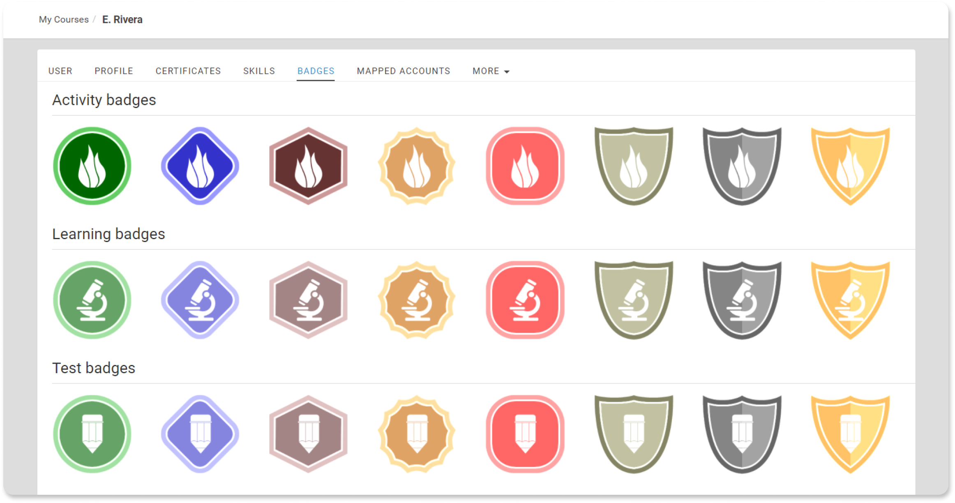
THE FINLAB TOOLKIT

Slide 19
THE FINLAB TOOLKIT
GAMIFICATION | GAME DYNAMICS & MECHANICS
LEVELS
Status & Expertise
Levels indicate long-term or sustained achievement. Used to identify status within a community or to unlock new missions, badges, activities, and rewards.

Slide 20
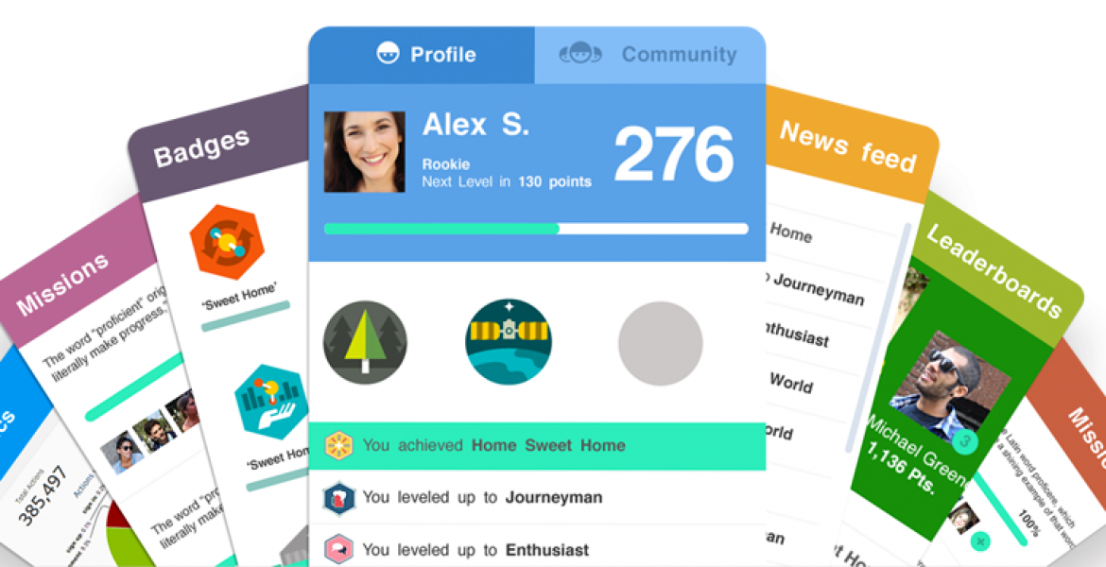
THE FINLAB TOOLKIT

Slide 21
THE FINLAB TOOLKIT
GAMIFICATION | GAME DYNAMICS & MECHANICS
TRANSPARENCY
Where everyone stands
Used to show where people stand on the metrics that matter. Individual and team profiles show progress in real-time and historically. Leaderboards show who’s just ahead and who’s behind as well as overall ranking on any number of metrics.

Slide 22
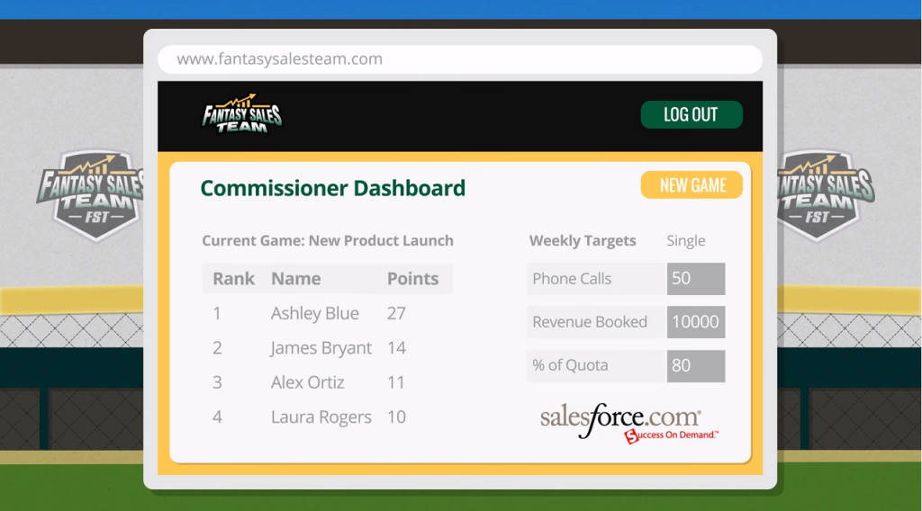
THE FINLAB TOOLKIT

